Slide 1
Week 1: Hadoop / HDFS / MapReduce

Slide 2
Plan for the week
What is Big Data
Hadoop ecosystem to work with it
HDFS for storage
MapReduce for computation

Slide 3
Big Data & Hadoop

Slide 4
Big Data
Collected data helps companies improve their services for the user: personally recommend movies, music, products, other users, etc.

Slide 5
Big Data
Big Data has 3 important properties (3V):
Volume – the amount of data is growing all the time. Some organizations process 10 TB, while others process 100 PB.
Velocity – the speed of data generation is also growing. Today billions of posts are generated daily on Facebook, Twitter, etc.
Variety – the diversity of data formats is high.
Today we analyze texts, images, audio recordings, videos, etc.
https://www.oracle.com/ru/big-data/what-is-big-data.html

Slide 6
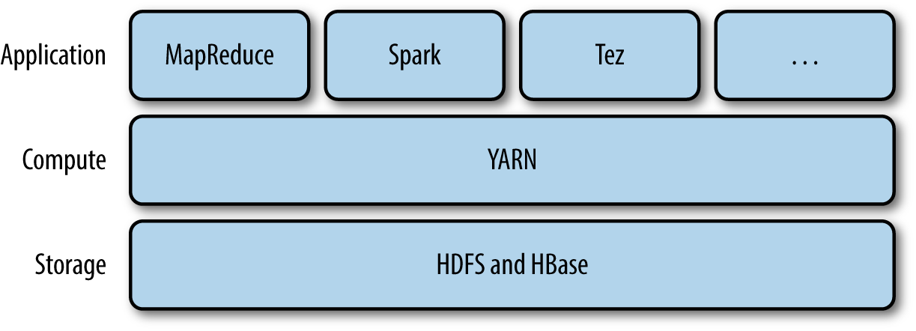
Hadoop ecosystem for Big Data
HDFS – distributed file system
YARN – cluster resource manager (CPU, RAM, etc)
MapReduce – API for distributed computing
http://grut-computing.com/HadoopBook.pdf

Slide 7
Scalability
When data is small and structured, it can be stored in a relational database (RDBMS).
To speed up processing in RDBMS you need a more powerful server (vertical scalability).
In Hadoop you can use a lot of commodity servers to speed up processing (horizontal scalability), which is much cheaper.

Slide 8
RDBMS vs Hadoop
 | RDBMS | Hadoop
Hardware | Powerful servers | Commodity hardware
Data volume | Small | Big
Response time | Instant response | Delayed response
Data format | Tables (structured) | Files (unstructured)

Slide 9
HDFS

Slide 10
Hadoop Distributed File System (HDFS)
Files are split into blocks, which are stored on different Data Nodes
Every block is replicated on many Data Nodes (w.r.t replication factor, e.g. 3)
Mapping filename → blocks is stored in memory of a Name Node

Slide 11
HDFS
block
node
https://hadoop.apache.org/docs/current/hadoop-project-dist/hadoop-hdfs/HdfsDesign.html

Slide 12
Why you need to replicate blocks
Let’s say a node fails with probability 0.001
What is the probability that at least 1 of 500 nodes fails?

Slide 13
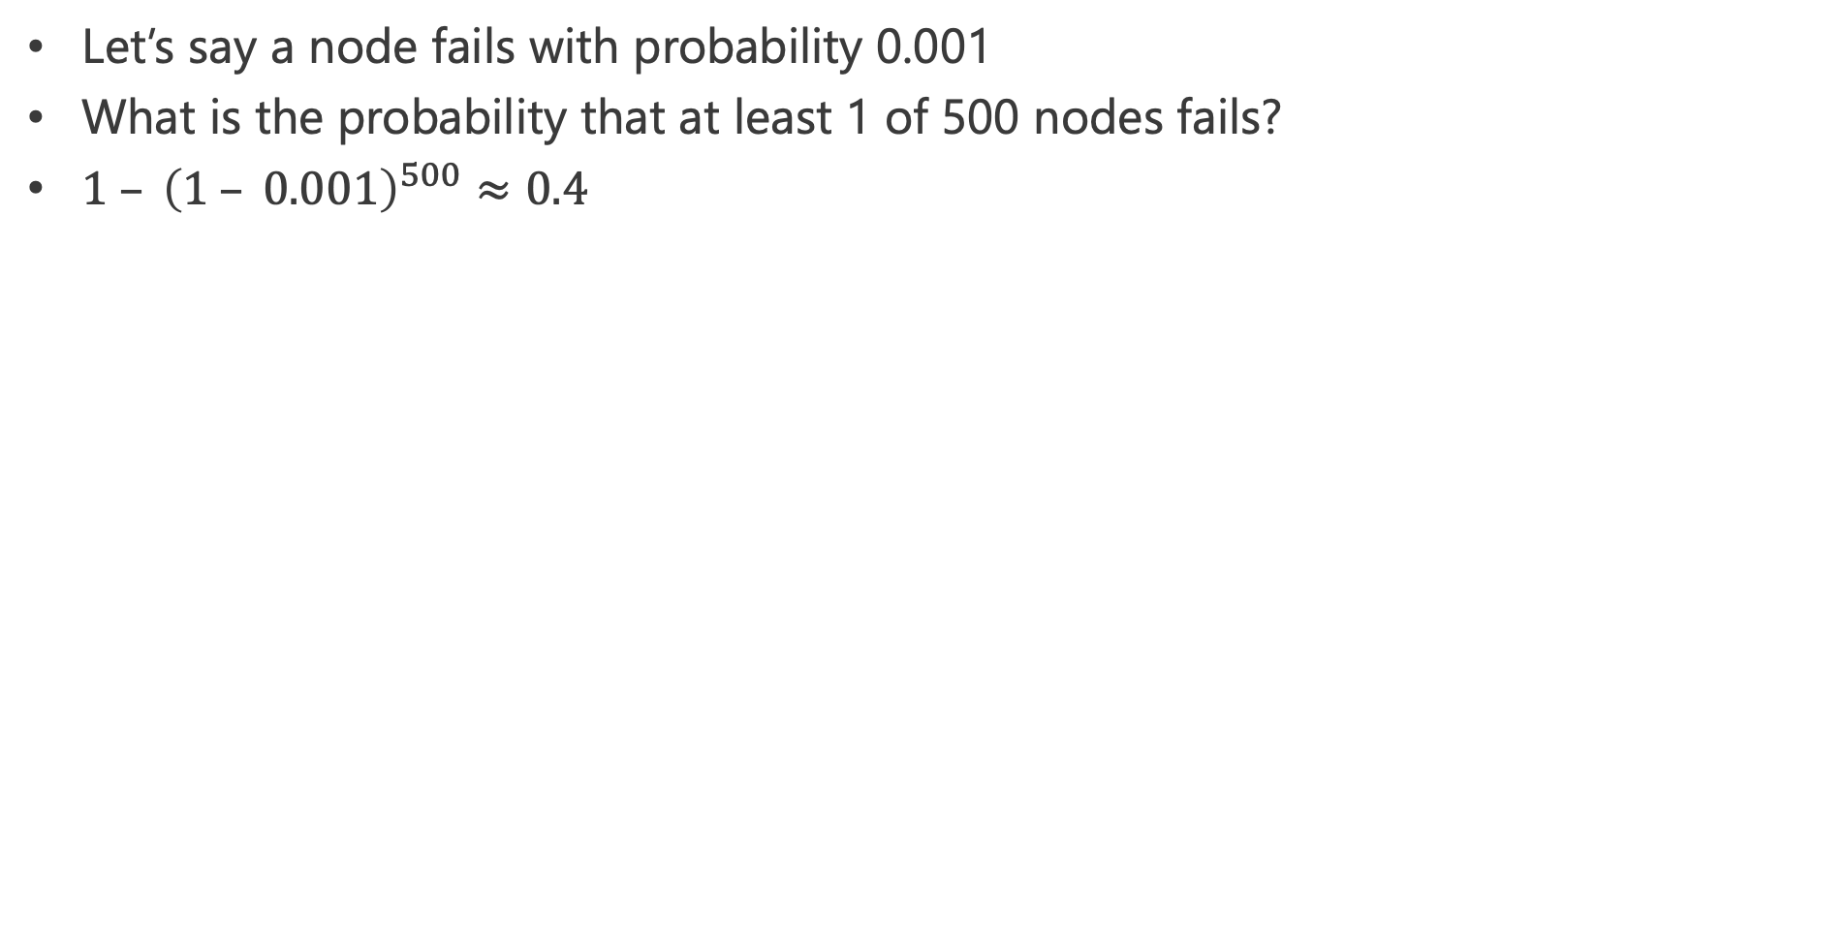
Why you need to replicate blocks
Let’s say a node fails with probability 0.001
What is the probability that at least 1 of 500 nodes fails?
$1 – {\left(1 – 0.001\right)}^{500}≈0.4$

Slide 14
Reading from HDFS
HDFS client
where are the blocks?
Name Node
http://grut-computing.com/HadoopBook.pdf

Slide 15
Reading from HDFS
HDFS client
where are the blocks?
Name Node
read the contents of the blocks
Data Node
Data Node
Data Node

Slide 16
Writing into HDFS
HDFS client
create a new file
Name Node
http://grut-computing.com/HadoopBook.pdf

Slide 17
Writing into HDFS
give me location for a new block (3 Data Nodes)
HDFS client
Name Node
Data Node
Data Node
Data Node

Slide 18
Writing into HDFS
give me location for a new block (3 Data Nodes)
HDFS client
Name Node
write the contents of the block
Data Node
Data Node
Data Node
replicate
replicate

Slide 19
Writing into HDFS
give me location for the next block or close the file
HDFS client
Name Node
block saved reliably
Data Node
Data Node
Data Node
replica saved
replica saved
client can wait for “block saved reliably” asynchronously, client can immediately start writing the next block

Slide 20
HDFS resiliency
Data Nodes report to Name Node that they're still alive (heartbeat). If heartbeat wasn’t received, Name Node may decide to decommission the node (pull it out of the cluster) replicating its blocks to another available node.
Name Node
I'm alive!
I'm alive!
?
Data Node
Data Node
Data Node
https://www.ibm.com/developerworks/library/wa-introhdfs/index.html

Slide 21
HDFS resiliency
Data Nodes report to Name Node that they're still alive (heartbeat). If heartbeat wasn’t received, Name Node may decide to decommission the node (pull it out of the cluster) replicating its blocks to another available node.
Name Node
replicate blocks
replicate blocks
Data Node
Data Node
Data Node
decommissioned

Slide 22
Word Count problem

Slide 23
Data locality
Blocks of a huge file are stored on different nodes
We can process them locally on respective nodes (reading fast from local disk)
We can achieve ideal parallelization for embarrassingly parallel tasks (which can be divided into independent sub-tasks, e.g. rows filtering in a huge table)

Slide 24
Word Count problem (Google)
We have a huge text file (the whole Internet)
We want to know the frequency of every word (e.g. for tf-idf)
Solution:
For each block we calculate the frequency of words in it (scales perfectly)
Aggregate frequencies from all blocks (somehow)

Slide 25
Naive approach
cat jumps
dog sits
cat
dog jumps
cat sleeps
cat: 1
jumps: 1
dog: 1
sits: 1
cat: 1
dog: 1
jumps: 1
cat: 1
sleeps: 1
cat: 3
dog: 2
jumps: 2
sits: 1
sleeps: 1
This node becomes the bottleneck!

Slide 26

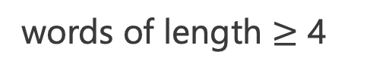
Divide the aggregation work
cat jumps
dog sits
cat
dog jumps
cat sleeps
cat: 1
jumps: 1
dog: 1
sits: 1
cat: 1
dog: 1
jumps: 1
cat: 1
sleeps: 1
cat: 1
cat: 1
cat: 1
dog: 1
dog: 1
jumps: 1
jumps: 1
sits: 1
sleeps: 1
words of length $<$ 4
words of length $≥$ 4

Slide 27
Independently process halves
cat jumps
dog sits
cat
dog jumps
cat sleeps
cat: 1
jumps: 1
dog: 1
sits: 1
cat: 1
dog: 1
jumps: 1
cat: 1
sleeps: 1
cat: 1
cat: 1
cat: 1
dog: 1
dog: 1
jumps: 1
jumps: 1
sits: 1
sleeps: 1
cat: 3
dog: 2
jumps: 2
sits: 1
sleeps: 1

Slide 28
MapReduce

Slide 29
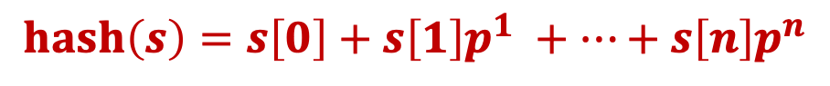
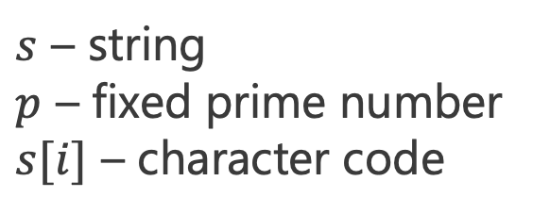
Divide the work into more tasks
Let’s say we want to divide the aggregation work into N tasks.
We will divide the work by hash(word) % N, which produces the node number where we need to send this word.
A good hash function produces numerical values that are uniformly distributed.
The example of a hash function (polynomial):
$$hash\left(s\right)=s\left[0\right]+s\left[1\right]p^{1} +…+s\left[n\right]p^{n}$$
$s$ – string
$p$ – fixed prime number
$s[i]$ – character code

Slide 30
Word Count Problem
cat jumps
dog sits
cat
dog jumps
cat sleeps
cat: 1
jumps: 1
dog: 1
sits: 1
cat: 1
dog: 1
jumps: 1
cat: 1
sleeps: 1
Map
cat: 1
cat: 1
cat: 1
dog: 1
dog: 1
jumps: 1
jumps: 1
sits: 1
sleeps: 1
Shuffle
hash(word) = 0
hash(word) = 1
Reduce
cat: 3
dog: 2
jumps: 2
sits: 1
sleeps: 1

Slide 31
MapReduce paradigm
key: value
key: value
key: value
key: value
key: value
key: value
key: value
key: value
key: value
key: value
key: value
key: value
Map
key: value
key: value
key: value
key: value
Shuffle
hash(key) = 0
hash(key) = 1
Reduce
key: value
key: value
key: value
key: value

Slide 32
MapReduce paradigm
Map:
(K1, V1) → List(K2, V2) (line number, “cat sleeps”) → [(“cat”, 1), (“sleeps”, 1)]
Shuffle:
Keys are divided by hash(key) % N into N partitions
Each partition is sorted by key (independently)
Reduce:
(K2, List(V2)) → List(K3, V3) (“cat”, (1, 1, 1)) → [(“cat”, 3)]

Slide 33
Hadoop MapReduce

Slide 34
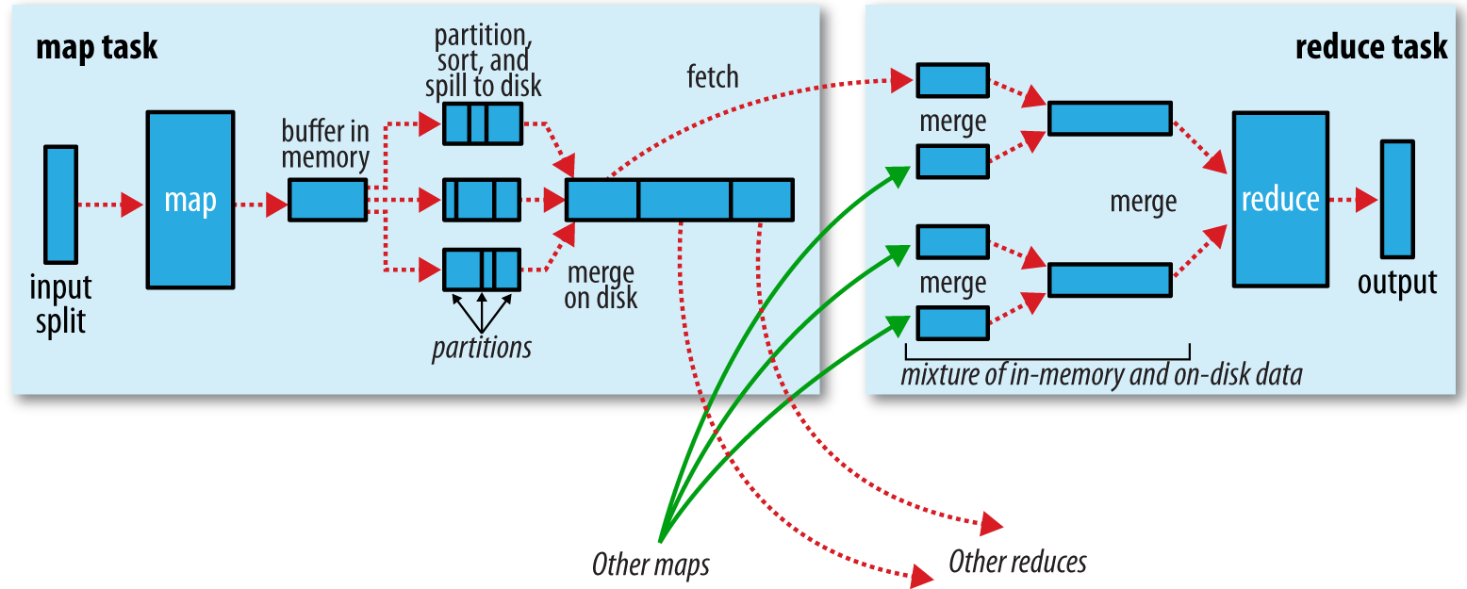
Accelerated shuffle
100MB
hash: 0, 1, 2
Map results can be sorted locally
You can then merge sorted Map results into one sorted result in linear time (merge sort)
http://grut-computing.com/HadoopBook.pdf

Slide 35
Accelerated shuffle
100MB
hash: 0, 1, 2
Map results can be sorted locally
You can then merge sorted Map results into one sorted result in linear time (merge sort)

Slide 36
Accelerated shuffle
100MB
hash: 0, 1, 2
Map results can be sorted locally
You can then merge sorted Map results into one sorted result in linear time (merge sort)

Slide 37
Working with HDFS
Block in HDFS
Block in HDFS
Block in HDFS
key: value
key: value
key: value
key: value
key: value
key: value
Map
key: value
key: value
key: value
key: value
Shuffle
hash(key) = 0
hash(key) = 1
Reduce
Block in HDFS
Block in HDFS

Slide 38
Reliability
If you lose a mapper, you can restart the task only for its blocks
When you lose a reducer, you re-collect data from all mappers only for its hash value

Slide 39
Working with YARN
create application
YARN client
Resource Manager
run Application Master
Node Manager
Node Manager
run other containers (e.g. mapper)

Slide 40
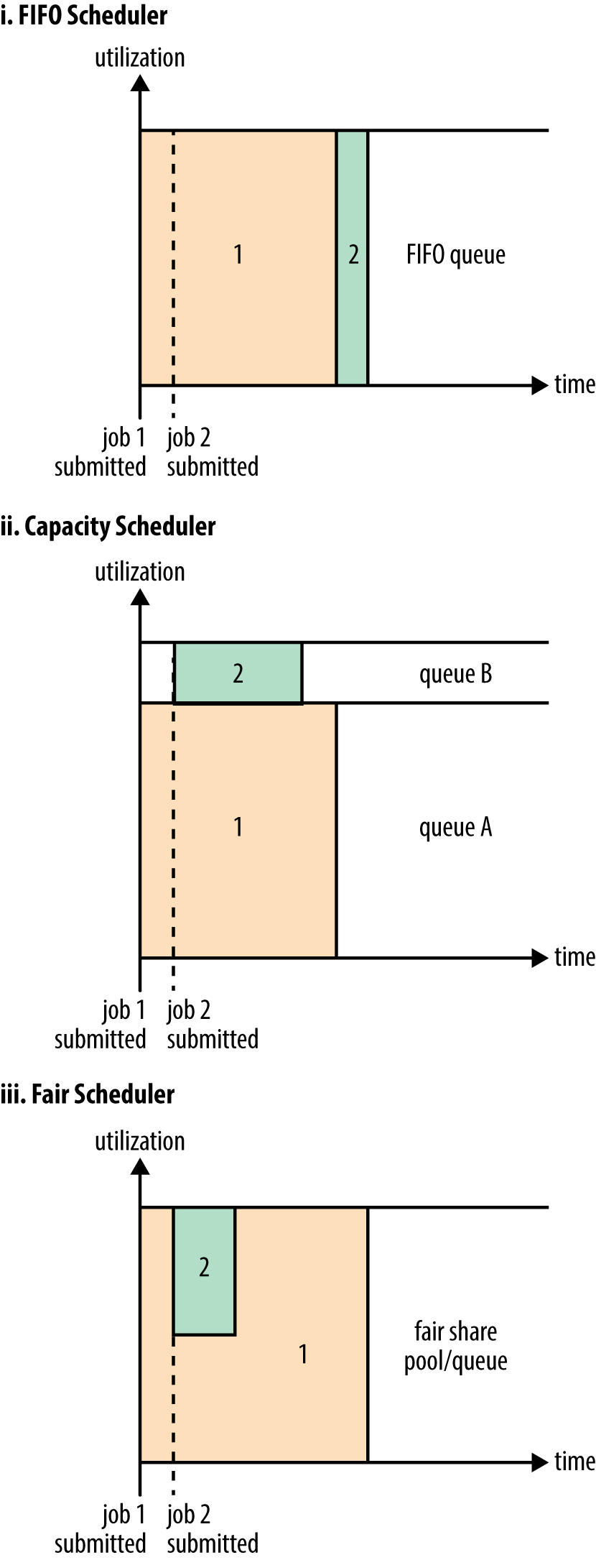
YARN scheduling

Slide 41
Real problem example

Slide 42
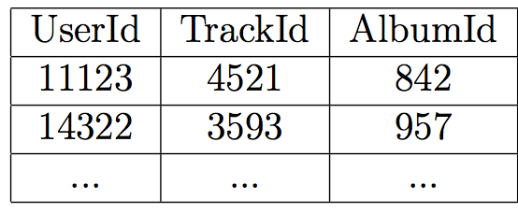
MapReduce example
Map: (K1, V1) → List(K2, V2)
Reduce: (K2, List(V2)) → List(K3, V3)
Let’s collect listening logs on Spotify. We want to find the most popular track in each album.

Slide 43
MapReduce example
Map: (K1, V1) → List(K2, V2)
Reduce: (K2, List(V2)) → List(K3, V3)
Let’s collect listening logs on Spotify. We want to find the most popular track in each album.
M: #, (user, track, album) → (album, track), 1 R: (album, track), (1,1,...) → (album, track), count

Slide 44
MapReduce example
Map: (K1, V1) → List(K2, V2)
Reduce: (K2, List(V2)) → List(K3, V3)
Let’s collect listening logs on Spotify. We want to find the most popular track in each album.
M: #, (user, track, album) → (album, track), 1 R: (album, track), (1,1,...) → (album, track), count
M: (album, track), count → album, (track, count) R: album, tracks → album, most popular track

Slide 45
Conclusion
Hadoop is created to handle Big Data and scale horizontally
HDFS is a distributed and reliable file system
MapReduce is a distributed and reliable way to process data stored in HDFS

